Slide 1

Data Science project: Aphasia
KB-74

Slide 2
Content
Summary
Progress
Results
Future

Slide 3
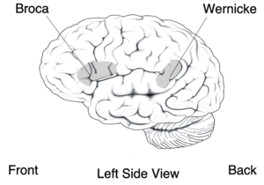
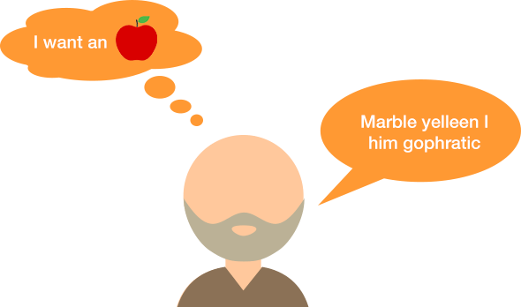
Aphasia
speech to text
Goal of the project: create a speech to text software that can successful translate speech from aphasia patients.

Slide 4

Progress
Interview
Scope
Plan of action
Notes:
The intervieuw we had a lot of information about aphasia patients.
And how aphasia works, the tools and exercises they use at rijndam.

Slide 5
Data….
Architecture….
API….

Slide 6
Data
58 patients
~ 5 audio files each patient
Duration between 5 - 10 min.
How do we transcribe…..?

Slide 7
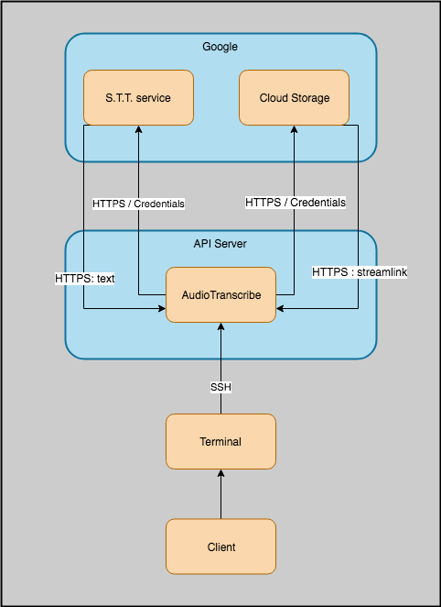
Architecture
S.T.T. / Cloud Storage
API
Limits

Slide 8
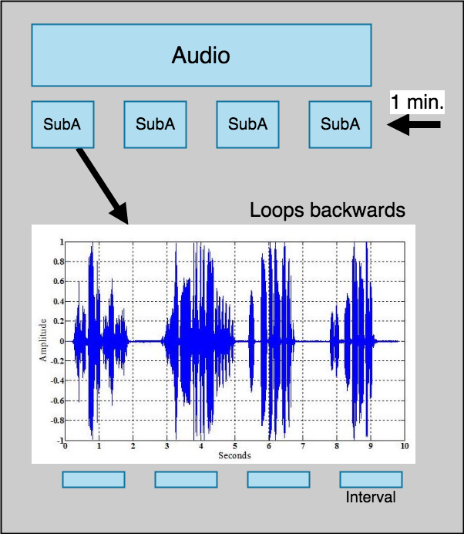
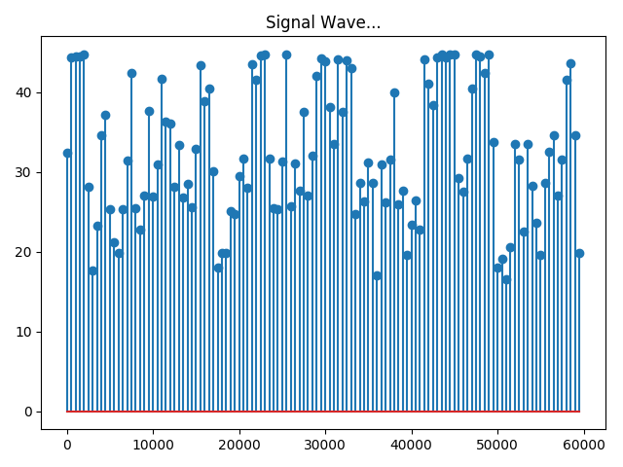
API
2 static methods
Cloud Storage
Audio slicing (Amplitude)
Timestamp p.w.
Batching
Notes:
What is dBFS?
'FS' stands for 'Full Scale' which means it shows the amplitude of the peak and 0 dBFS is the highest Signal - Amplitude level achievable in a digital audio file. Every value will be a negative number.

Slide 9
Future
Research:
Developing speech to text
Categorise the mistakes
Text analytics
Notes:
Semantics
Phonology
Syntactic

